Slide 1
Inception, ResNet, and MobileNet
Inception, ResNet, and MobileNet are the convolutional neural networks commonly used for an image classification task.
Why such many kinds of networks are needed?
Inception is created to serve the purpose of reducing the computational burden of deep neural nets while obtaining state-of-art performance.
As the network goes deeper, the computational efficiency will also decrease, therefore the authors of Inception were interested in finding a solution to scale up neural nets without increasing computational cost.

Slide 2
While Inception focuses on computational cost, ResNet focuses on computational accuracy.
Intuitively, deeper networks should not perform worse than the shallower networks, but in practice, the deeper networks performed worse than the shallower networks, caused not by overfitting, but by an optimization problem.
Shortly, the deeper the network, the harder the network to be optimized.

Slide 3
The trend in the computer vision is to make deeper and more complicated network to achieve higher accuracy.
However, deeper networks come with the tradeoff of size and speed. In real applications such as an autonomous vehicle or robotic visions, the object detection task must be able to be done on the computationally limited platform.
MobileNet is developed to solve this problem, which is a network for embedded vision applications and mobile devices.

Slide 4
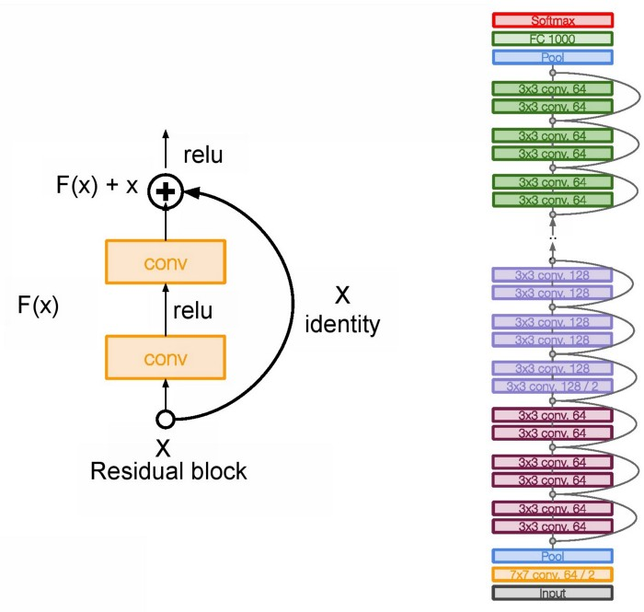
ResNet

Slide 5
The main base element of ResNet is the residual block.
As we go deeper into the network with a large number of layers, computation becomes more complex.
These layers put on top of each other and every layer try to learn some underlying mapping of the desired function and instead of having these blocks, we try and fit a residual mapping.

Slide 6
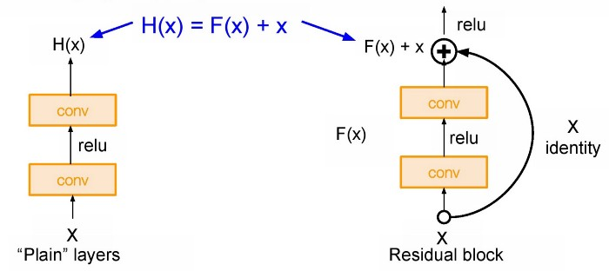
as we go deeper into the network it is so hard to learn H(X) as we have a large number of layers.
So here we used skip connection and learning F(x) direct input of x as the final output. So F(x) is called as a Residual.

Slide 7
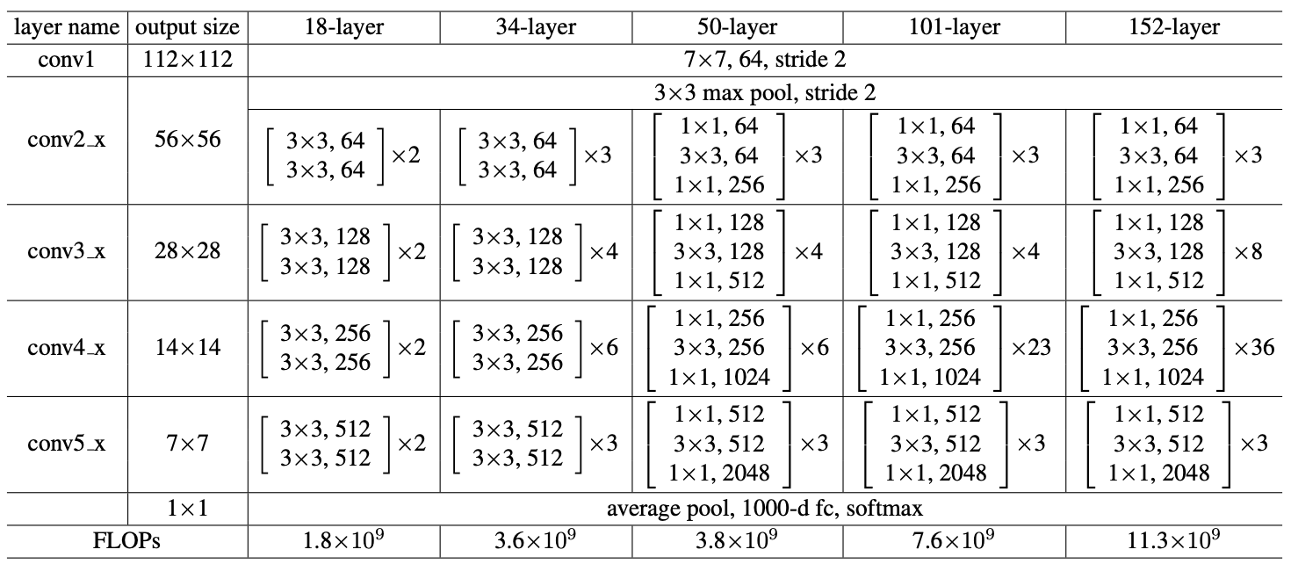

Slide 8
In ResNet, stacks all these blocks together very deeply.
Another thing with this very deep architecture is that it is enabling up to 150 layers deep of this, and then what we do is we stack all these layers periodically.
We also double the number of filters and downsample spatially using stride two.
In the end, only fully connected layer 1000 to output classes

Slide 9
Hyperparameters
In ResNet, it uses Batch Normalization after every conv layer.
It also uses SGD + Momentum.
The learning rate is 0.1 and is divided by 10 as validation error becomes constant.
Moreover, batch-size is 256 and weight decay is 1e-5. T
he important part is there is no dropout is used in ResNet.

Slide 10
Increasing the depth (number of layers) is not the only way to make a model bigger.
What about increasing both the depth and width of the network while keeping computations to a constant level?
The main purpose is dimension reduction, by reducing the output channels of each convolution block. Then we can process the input with different kernel sizes.
This in turn allows to not only increase the depth, but also the width of the famous GoogleNet by using Inception modules. The core building block, called the inception module, looks like this:

Slide 11
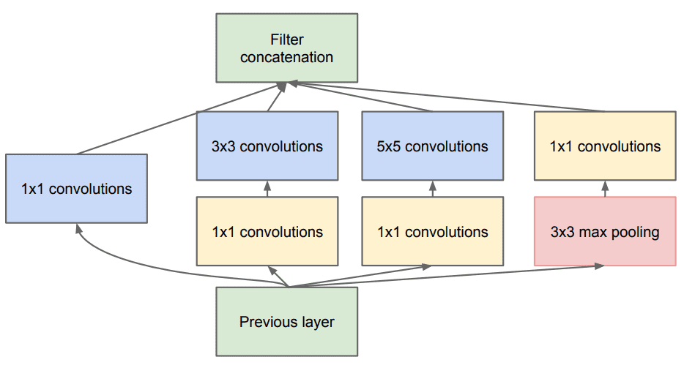
InceptionNet

Slide 12
In general, a larger kernel is preferred for information that resides globally, and a smaller kernel is preferred for information that is distributed locally.
The InceptionNet/GoogLeNet architecture consists of 11 inception modules stacked together, with max-pooling layers between (to halve the spatial dimensions). It consists of 22 layers (27 with the pooling layers). It uses global average pooling after the last inception module.

Slide 13
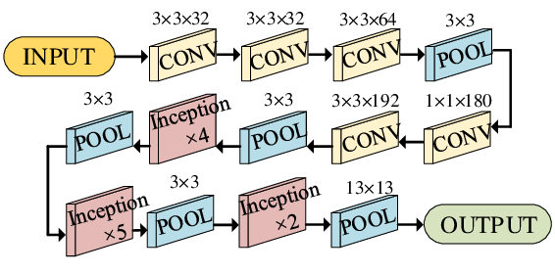

Slide 14
Inception v3
Inception v3 mainly focuses on burning less computational power by modifying the previous Inception architectures. This idea was proposed in the paper Rethinking the Inception Architecture for Computer Vision, published in 2015.
In comparison to VGGNet, Inception Networks (GoogLeNet/Inception v1) have proved to be more computationally efficient, both in terms of the number of parameters generated by the network and the economical cost incurred

Slide 15
The architecture of an Inception v3 network is progressively built, step-by-step, as explained below:
1. Factorized Convolutions: this helps to reduce the computational efficiency as it reduces the number of parameters involved in a network. It also keeps a check on the network efficiency.
2. Smaller convolutions: replacing bigger convolutions with smaller convolutions definitely leads to faster training. Say a 5 × 5 filter has 25 parameters; two 3 × 3 filters replacing a 5 × 5 convolution has only 18 (3*3 + 3*3) parameters instead.

Slide 16
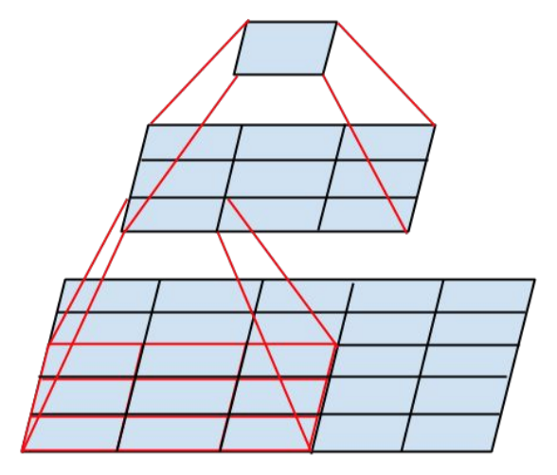
In the middle we see a 3x3 convolution, and below a fully-connected layer. Since both 3x3 convolutions can share weights among themselves, the number of computations can be reduced.

Slide 17
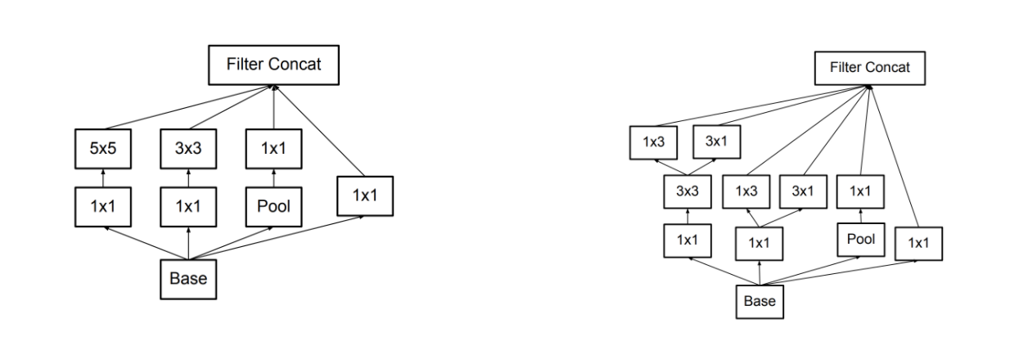
Asymmetric convolutions: A 3 × 3 convolution could be replaced by a 1 × 3 convolution followed by a 3 × 1 convolution. If a 3 × 3 convolution is replaced by a 2 × 2 convolution, the number of parameters would be slightly higher than the asymmetric convolution proposed.

Slide 18
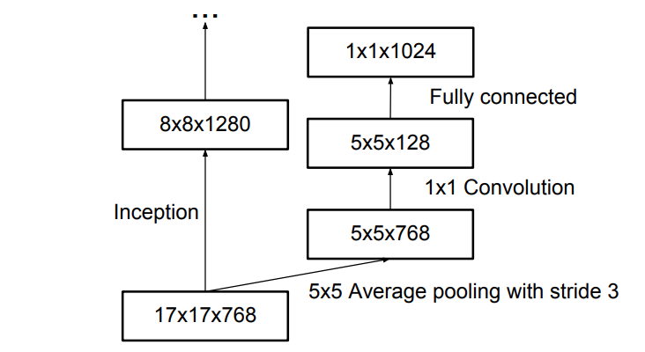
Auxiliary classifier: an auxiliary classifier is a small CNN inserted between layers during training, and the loss incurred is added to the main network loss. In GoogLeNet auxiliary classifiers were used for a deeper network, whereas in Inception v3 an auxiliary classifier acts as a regularizer.

Slide 19
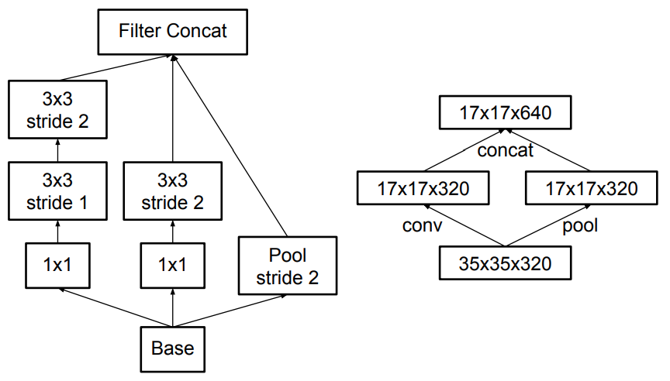
Grid size reduction: Grid size reduction is usually done by pooling operations. However, to combat the bottlenecks of computational cost, a more efficient technique is proposed:

Slide 20
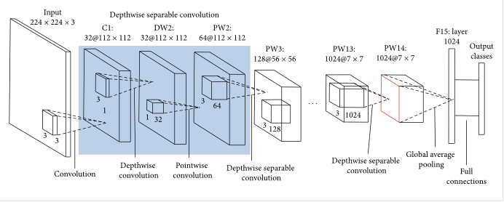
MobileNet

Slide 21
As the name applied, the MobileNet model is designed to be used in mobile applications, and it is TensorFlow’s first mobile computer vision model.
MobileNet uses depthwise separable convolutions.
It significantly reduces the number of parameters when compared to the network with regular convolutions with the same depth in the nets.
This results in lightweight deep neural networks.

Slide 22
Depthwise separable convolution
A depthwise separable convolution is made from two operations.
Depthwise convolution.
Pointwise convolution.
MobileNet is a class of CNN that was open-sourced by Google, and therefore, this gives us an excellent starting point for training our classifiers that are insanely small and insanely fast.

Slide 23
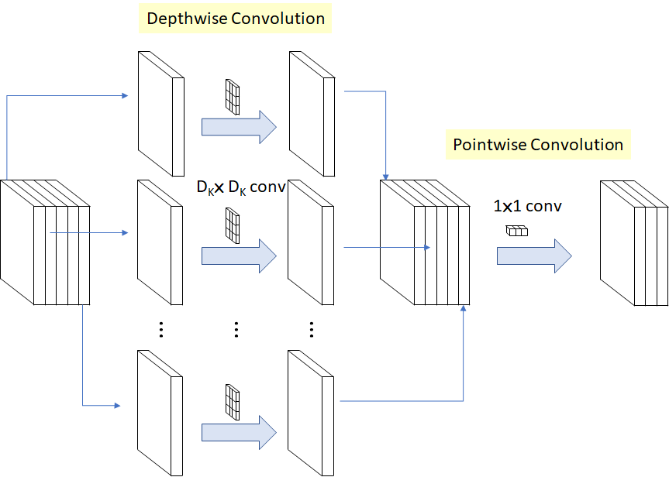
Depthwise Separable Convolution

Slide 24
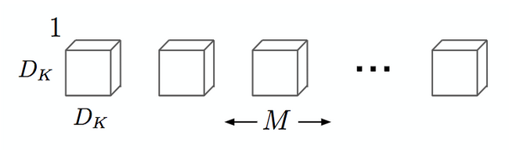
Depthwise convolution is the channel-wise DK×DK spatial convolution. Suppose in the figure above, and we have five channels; then, we will have 5 DK×DK spatial convolutions.
Pointwise convolution is the 1×1 convolution to change the dimension.
Depthwise convolution.

Slide 25
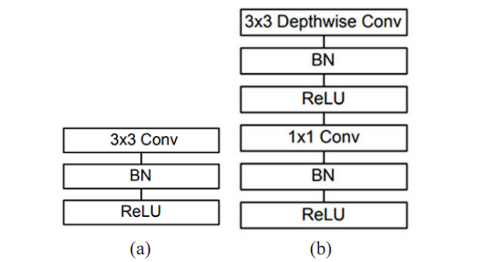
Fig. (a) Standard convolutional layer with batch normalization and ReLU. (b) Depth-wise separable convolution with depth-wise and pointwise layers followed by batch normalization and ReLU.

Slide 26
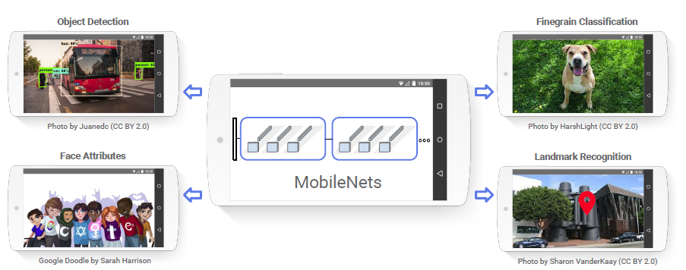
MobileNet for real life

Slide 27
The speed and power consumption of the network is proportional to the number of MACs (Multiply-Accumulates) which is a measure of the number of fused Multiplication and Addition operations.
https://medium.com/analytics-vidhya/image-classification-with-mobilenet-cc6fbb2cd470

